Slide 1
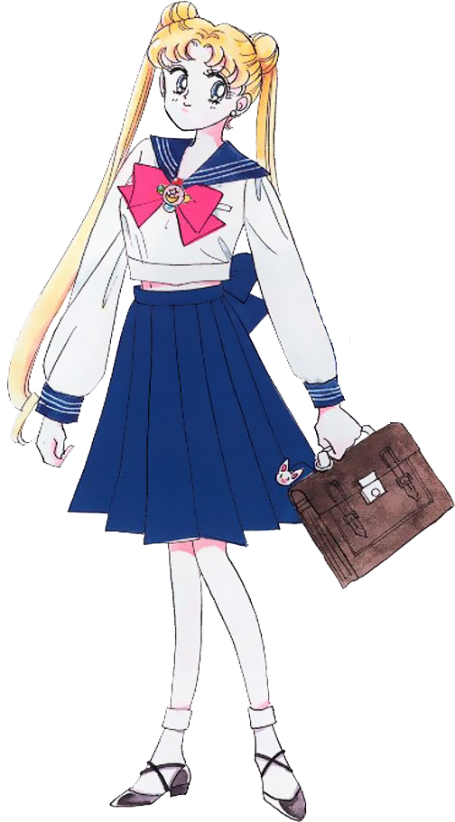
Unitarian Universalist
My Immersion Experience
By
Manuel

Slide 2
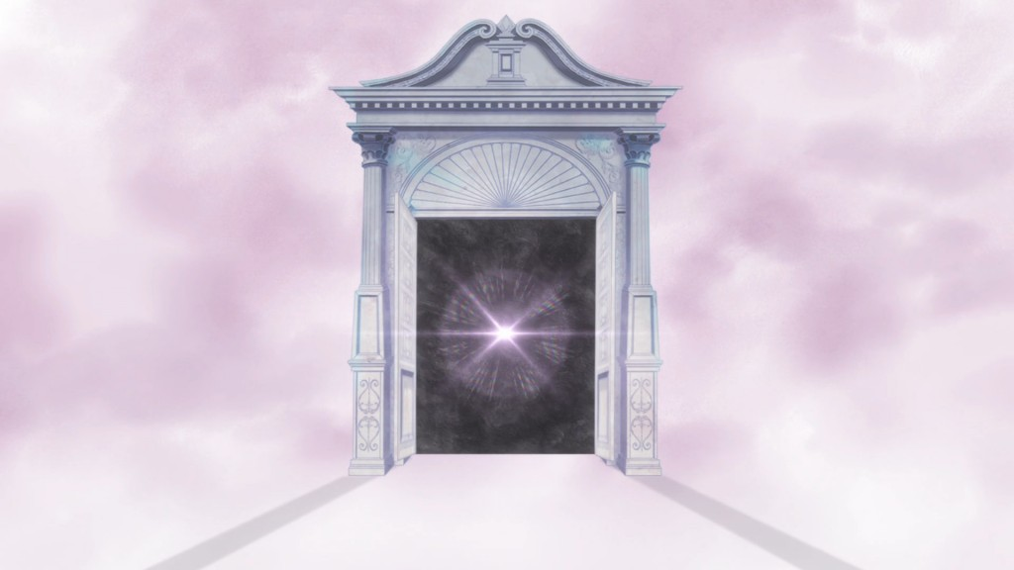
BUT before the main presentation today, I must reflect a little on my past!
I call upon thee...Guardian of space and time...Sailor Pluto!!!!
Open the door to the past so we can do a litle nostalgic fueled self-reflection!

Slide 3
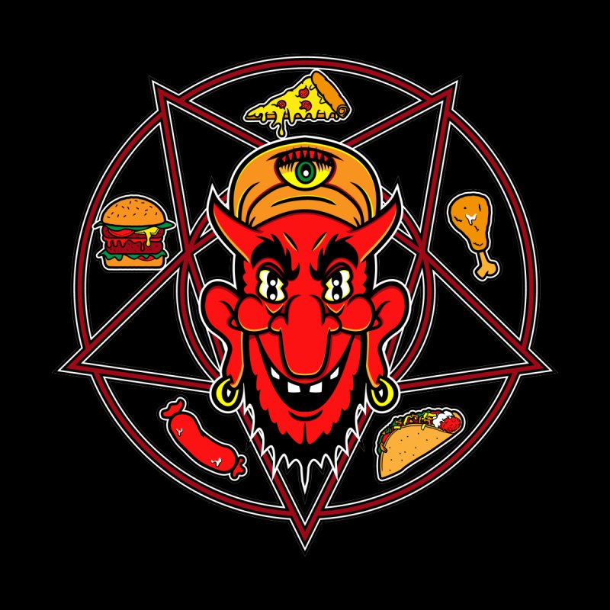
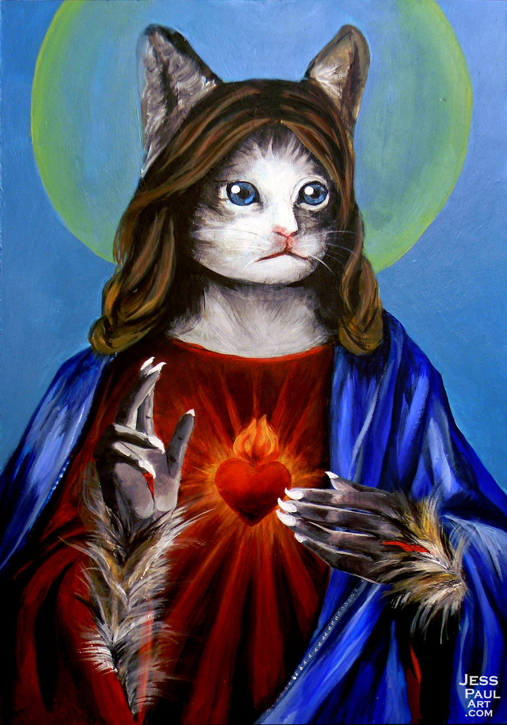
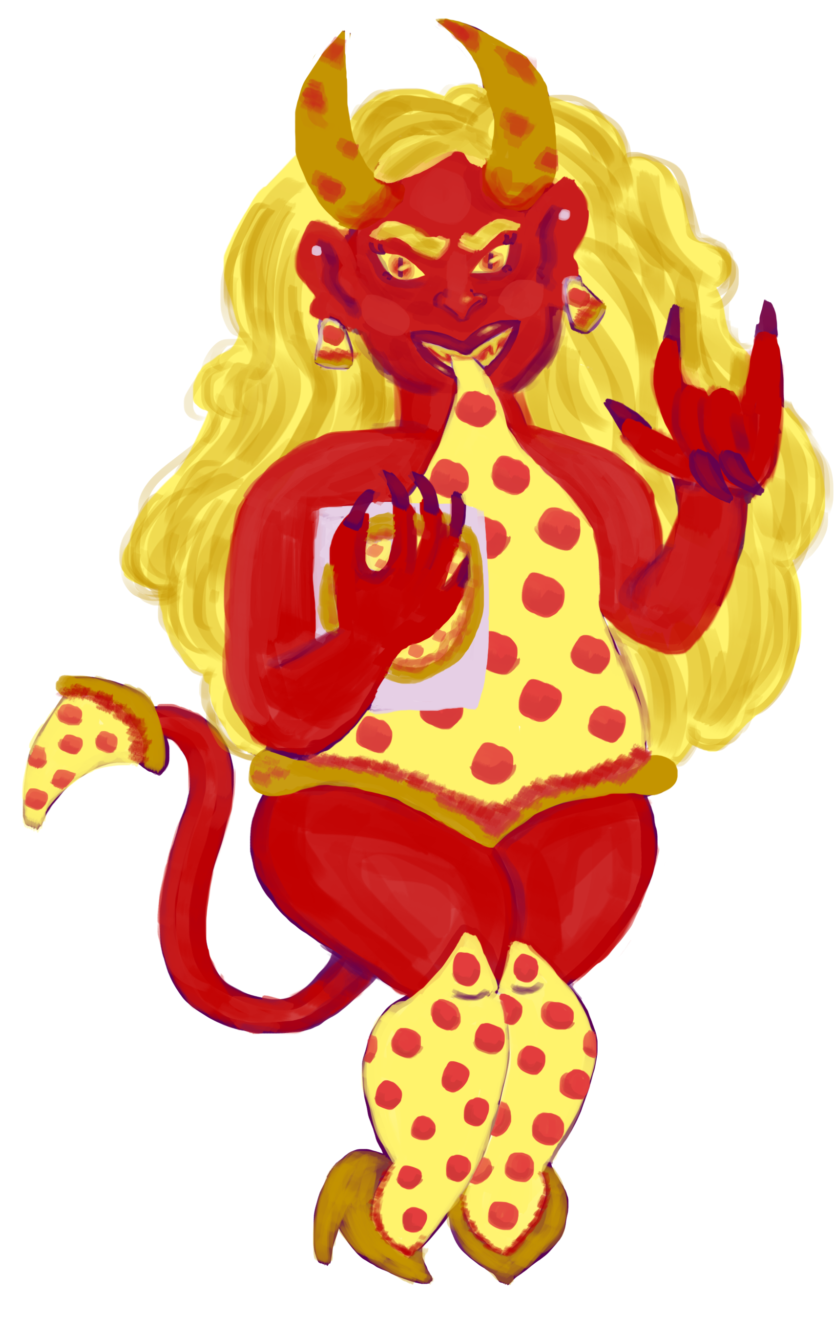
My "Not Too" Distant Past Views on Religion...
CHILDHOOD: Ages 5-13
My TEENS / MOst of UNDERGRAD: Ages 14-21
Viewed going to church as being the annoying event before getting to eat Taco Bell on Sundays
Appericated my mom being casual in her faith compared to the parents of my other friends
Dropped out of Catechism after confrontation with hostile Deacon John
Avoided relgion and others that indentified as being religious and prefered to study astrology
Lost my first major gay relationship to a guy who left me for Jesus
Became super anti-religious and aggressive toward all religious people, art and ideas

Slide 4
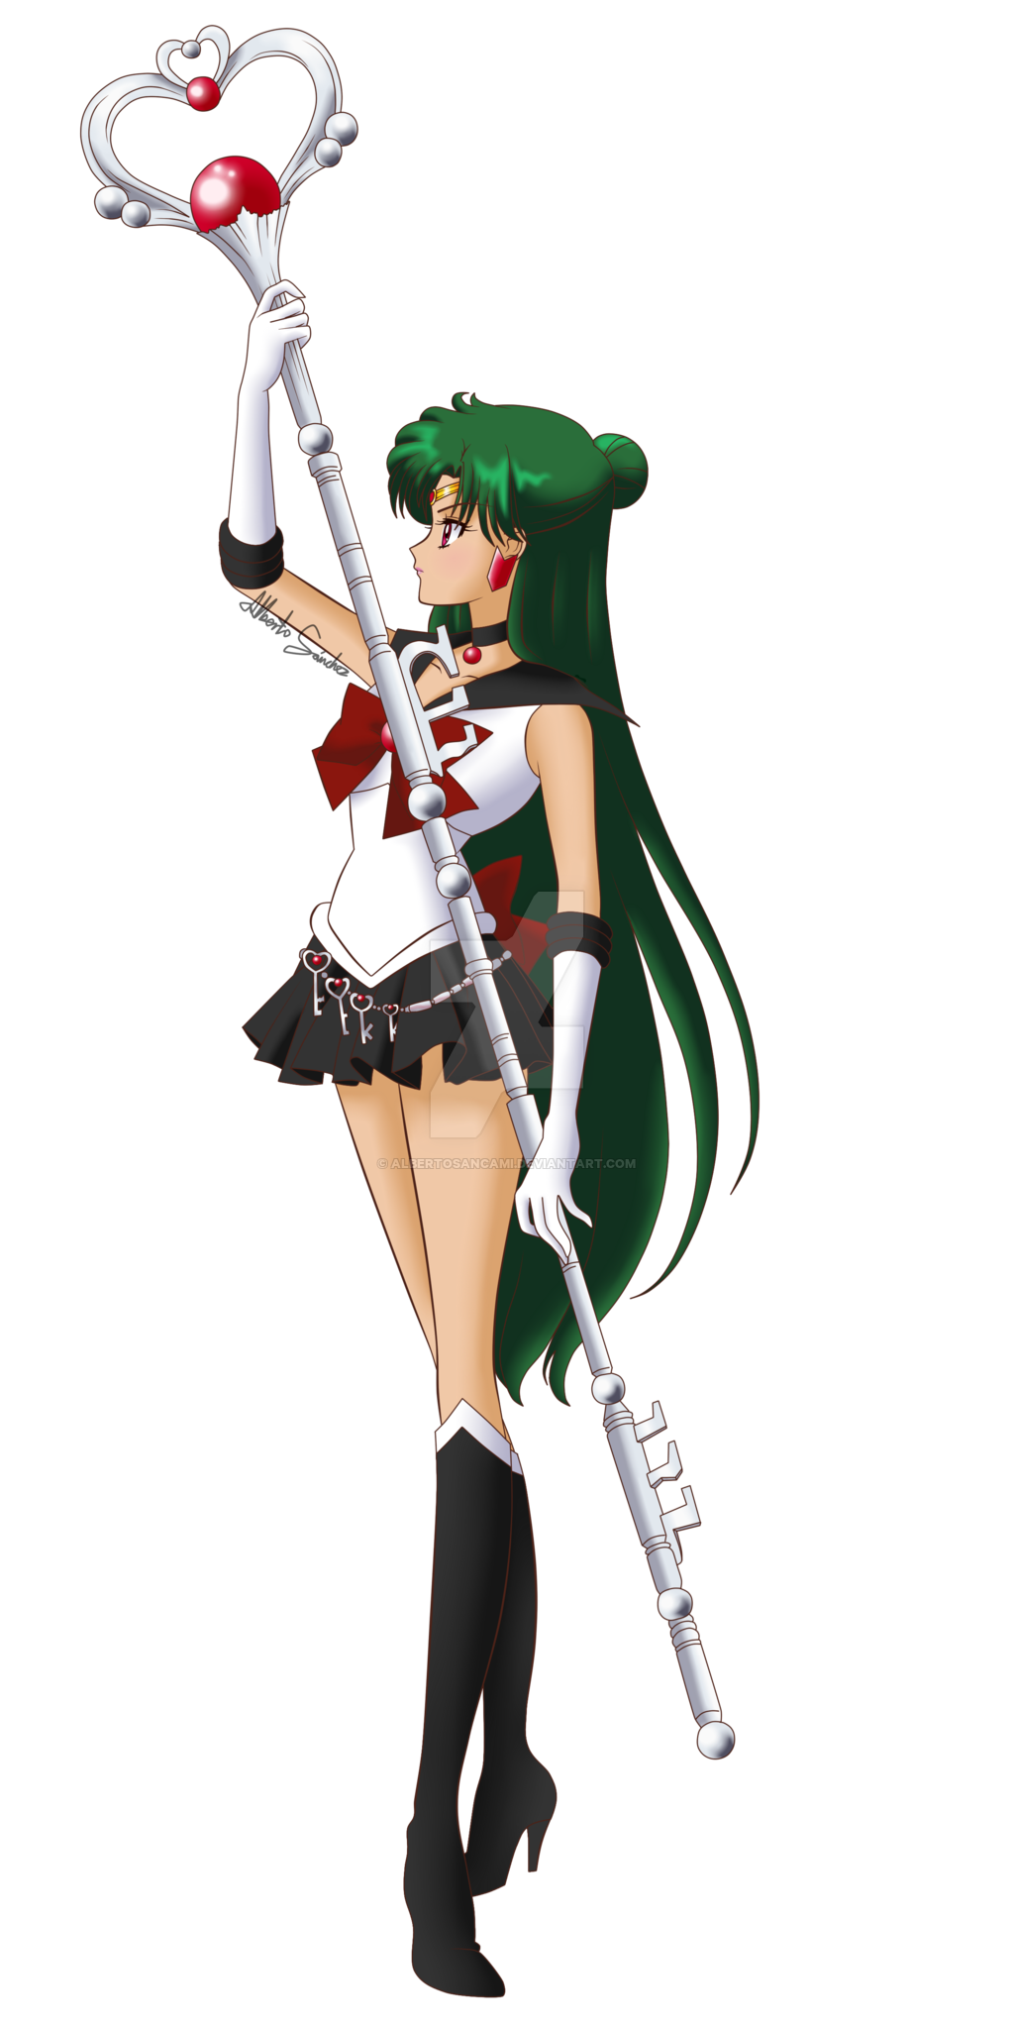
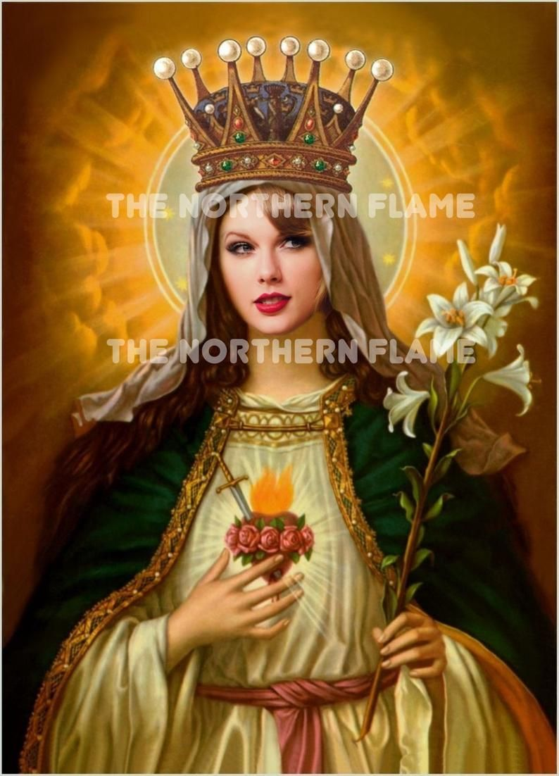
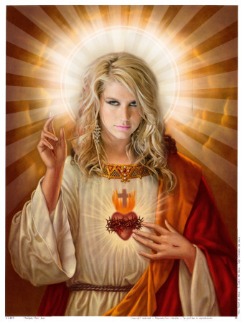
Saved by Sister Swift and Holy Ke$ha
Through the combined musical efforts of Taylor Swift and Ke$ha on one playlist to my ex,...something clicked inside of me!
I found some relief from my first major heartbreak through music as well as a way to begin the process of learning to accept religion.
For some, religion brought happieness and meaning into their lives.
Pluto now bring us back to current times!!!

Slide 5
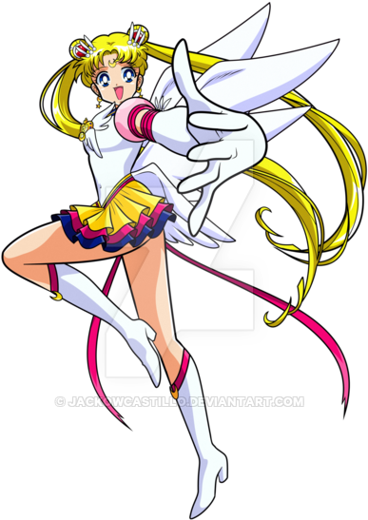
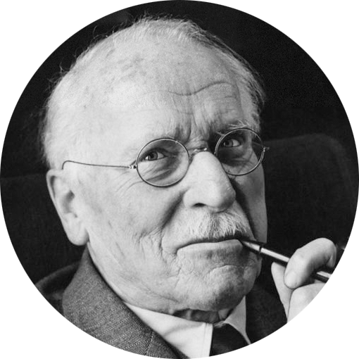
My Spirituality in Present Times
Agnostic but belief in some form of higher-power.
Cult-like obession with the MBTI personality typology system.
Meditates frequently while using natural crsytals along with my cat Pluto.
Personal value system derrived from lessons taught by my childhood heroine Sailor Moon as well as the philosophical teachings of Daddy Jung.

Slide 6
My thoughts when learning about the requirements of this project...
Mehhh... I'd rather not.
But if I gotta do it then it will give me a chance to test just how grown I really think I've become with not being so easily triggered by religion anymore.
AT LEAST IT AIN'T A PROJECT ON THAT TRASH FILM WE HAD TO WATCH THAT I NEED NOT MENTION THE TITLE!!!

Slide 7
My Interview with members of Unitarian Universalist Fellowship of Lafayette, LA (9/6/2020)-10:30AM
I felt a little nervous attending a relgious gathering with being an openly gay man in the south. (Even with it being virtual through zoom)
I purposely did not research any information on "UU" to approach the meeting from a neutral perspective. (Tried to enter the experience being as un-biased as possible)

Slide 8
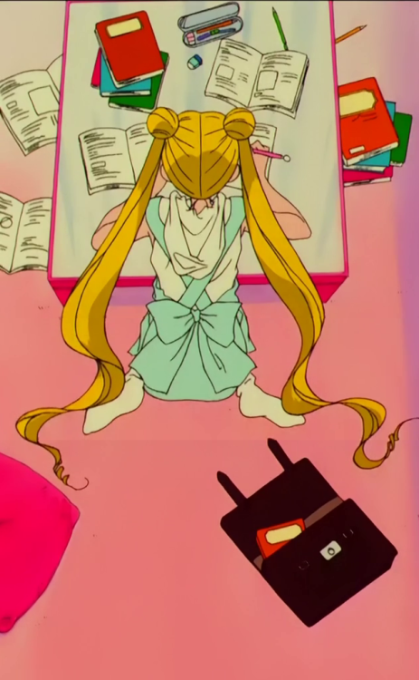
Some Things / Facts / Ideas I Learned During the Interview with UU Lafayette Fellowship
"UU" is their prefered informal manner of addressing their religion.
Lafayette chapter first founded in 1957
Members back then met at each other's houses, public places like UL, rented motel rooms, practiced in donated spots like Teche Electric, Cite De Arts, Yoga studios and accupuncture facilities.
One member joked about the most common public misconception about the Unitarian Universalist faith is the belief that they are part of some kind of cult.
One member described the congregation as being a group of "Free-thinkers who want to broaden their horizons while doing good for the community."

Slide 9
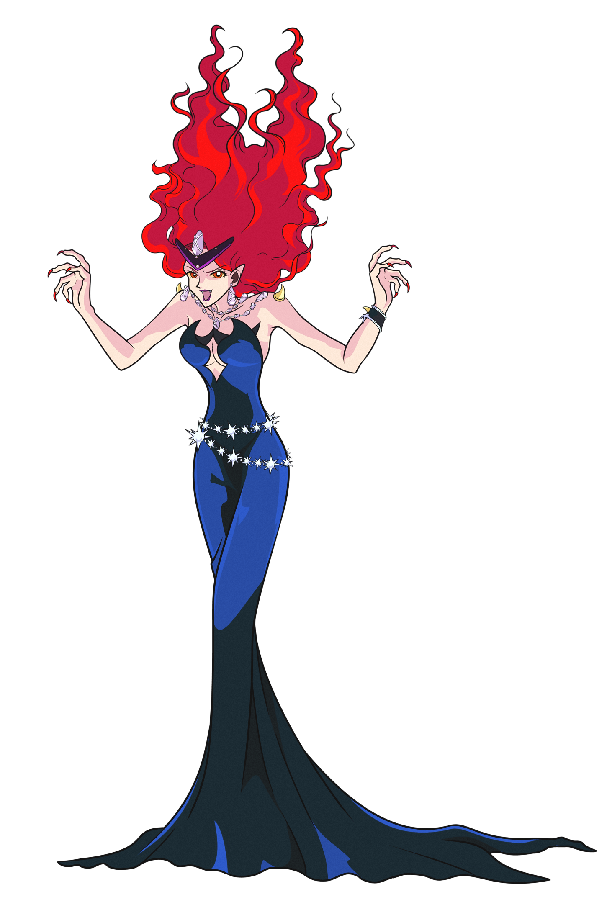
Stereotypes Brought to Mind During this Immersion Experience
Non-mainstream or Westernized religions being viewed as "Cult-like"
Western relgious People presumed conservative
Known for decades as a "haven of starchy humanists" (Lee, 1996).
sensationalized media accounts applied the cult label to groups as sociologically disparate as "moonies" and neopagans. In popular usage, the term now suggests a deviant religious group composed of highly committed but troubled and/or brainwashed members under the powerful (even malign) control of a charismatic leader (Lee, 1996).
Officially creedless, UUs pursue radically individual quests for "truth and meaning." UU churches dedicate themselves to supporting each member's personal search for answers to life's ultimate questions (Lee, 1996).
The Unitarian Universalist have embraced feminism and LGBT liberation movements for years (McKanan, 2013).
Drawing on a long heritage of support for birth control, Unitarian Universalism repeatedly advocated for abortion rights. A few ministers had performed gay and lesbian marriages long before Stonewall, a few came out of the closet around that time, and the denomination declared its solidarity with gay liberation in 1970 (McKanan, 2013).
Unitarian Universalists also pioneered religiously based sex education with “About Your Sexuality,” a 1970 curriculum that empowered children to make thoughtful choices about their sexual behavior (McKanan, 2013).

Slide 10
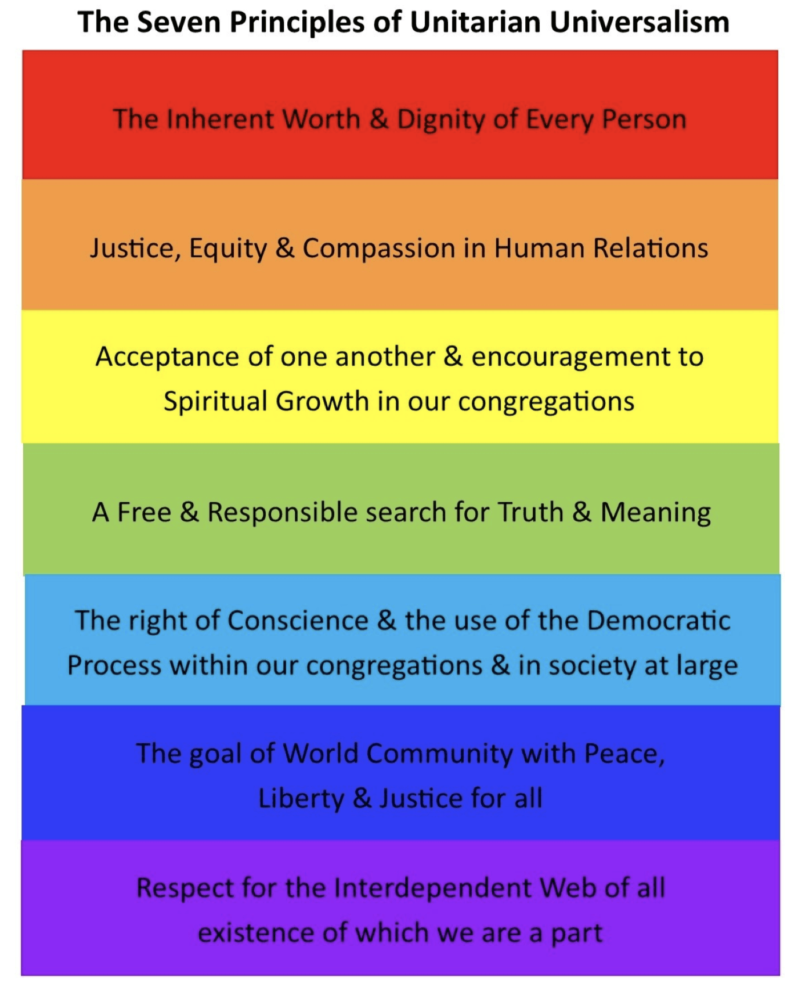
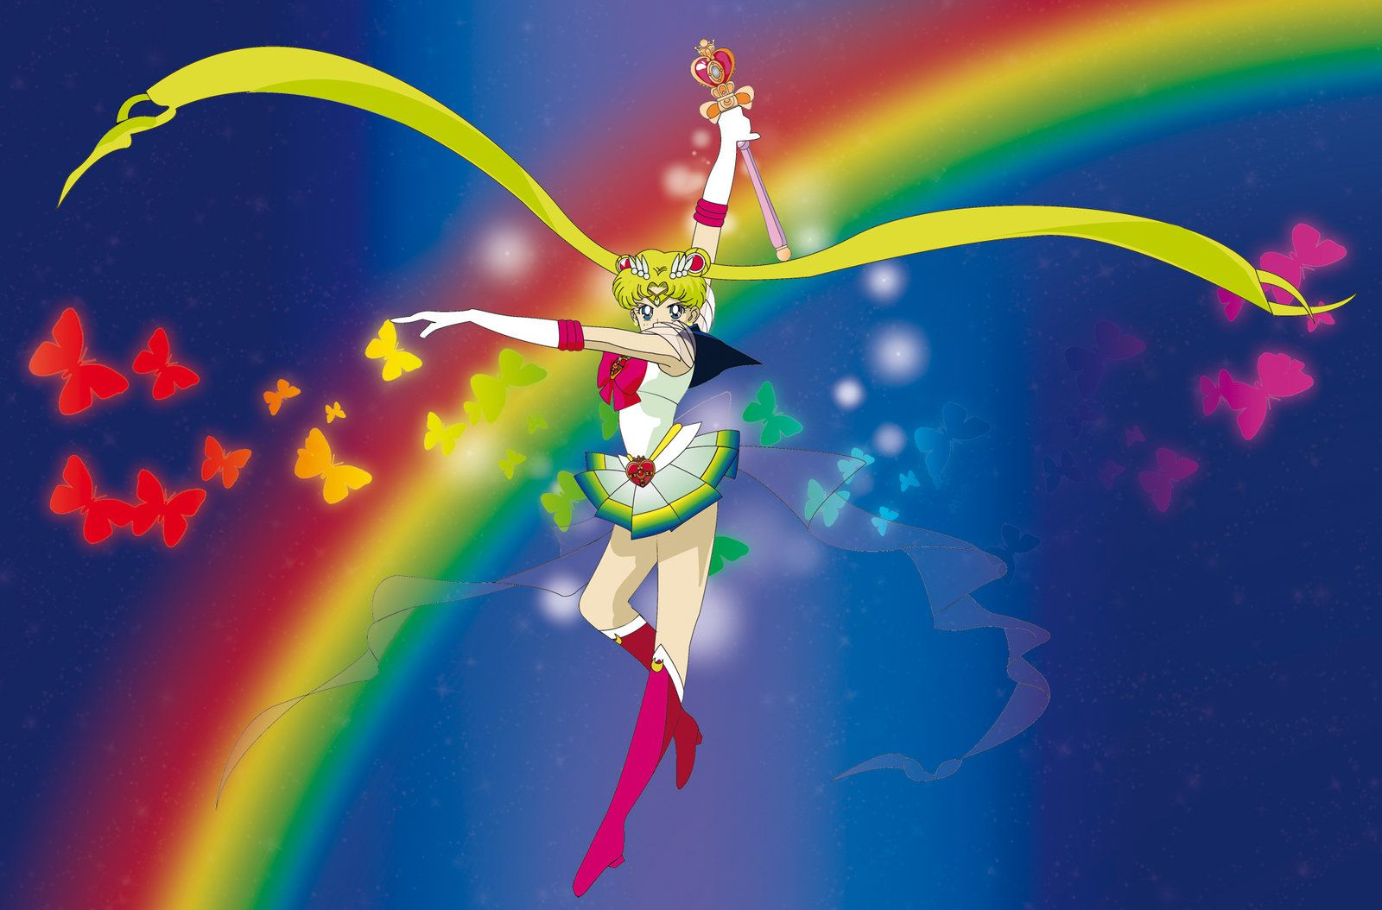
Unitarian Universalism CORE VALUES
During my Interview with Hunter Miller, the president of the Lafayette chapter, he reffered some of my inquiries about their belief system to viewing a link he sent from the UUs main website https://www.uua.org/
He wanted me to read up on the 7 principles that their faith is based around

Slide 11
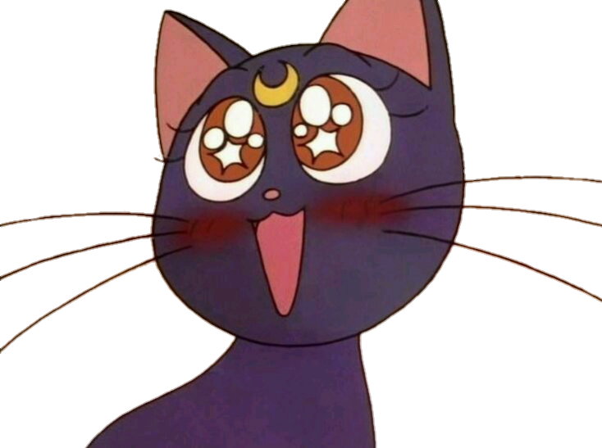
Attending my first mass with the Unitarian Universalist Fellowship of Lafayette, LA (9/6/2020)-11:00AM
After being pleasently surprised with how open and kind everyone was during my short interview process I felt myself excited to witness a typical UU mass (at least a virtual one during COVID times.)
I continiosuly found myself smiling internally while my face remained frozen in a state of utter bewilderment.

Slide 12
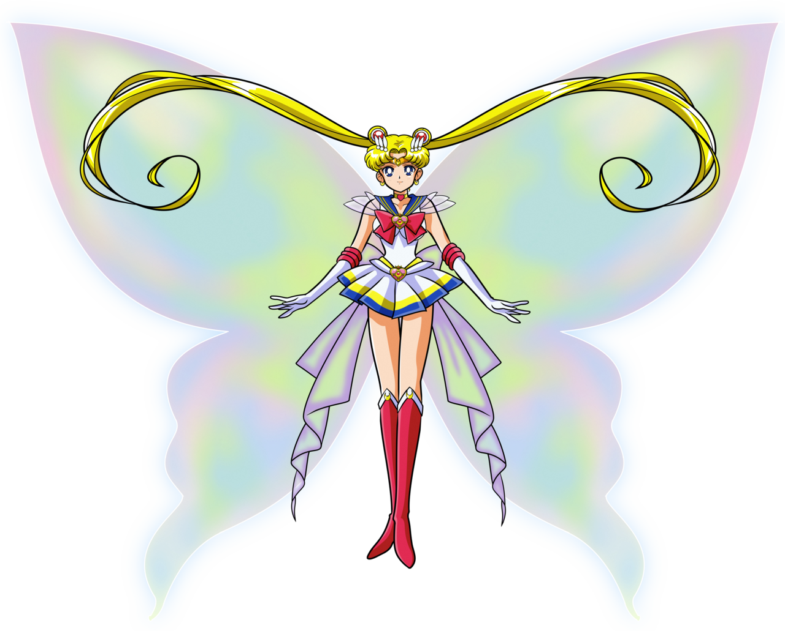

Slide 13
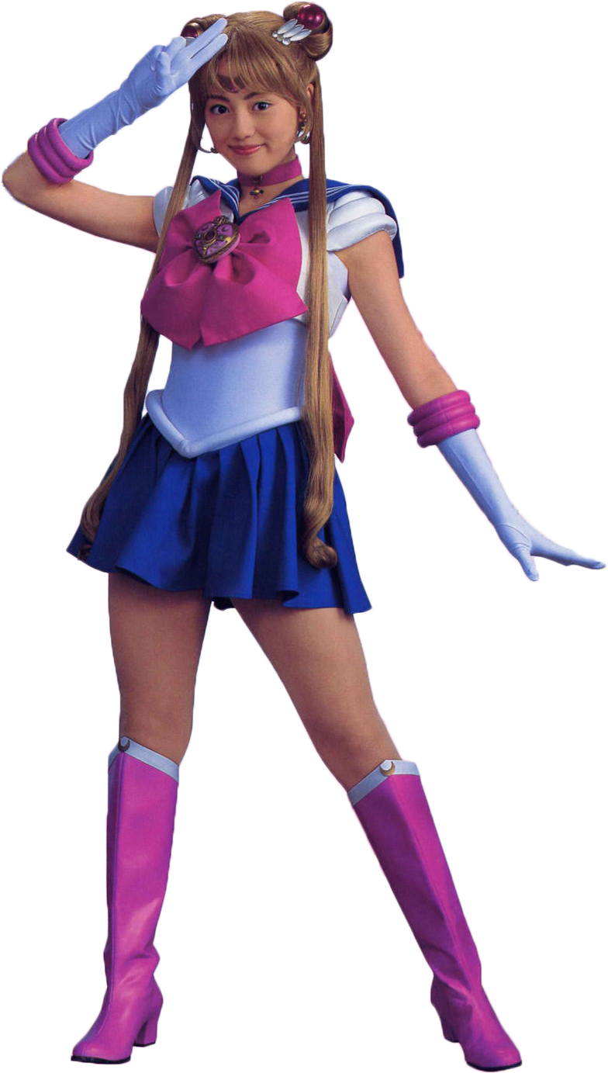
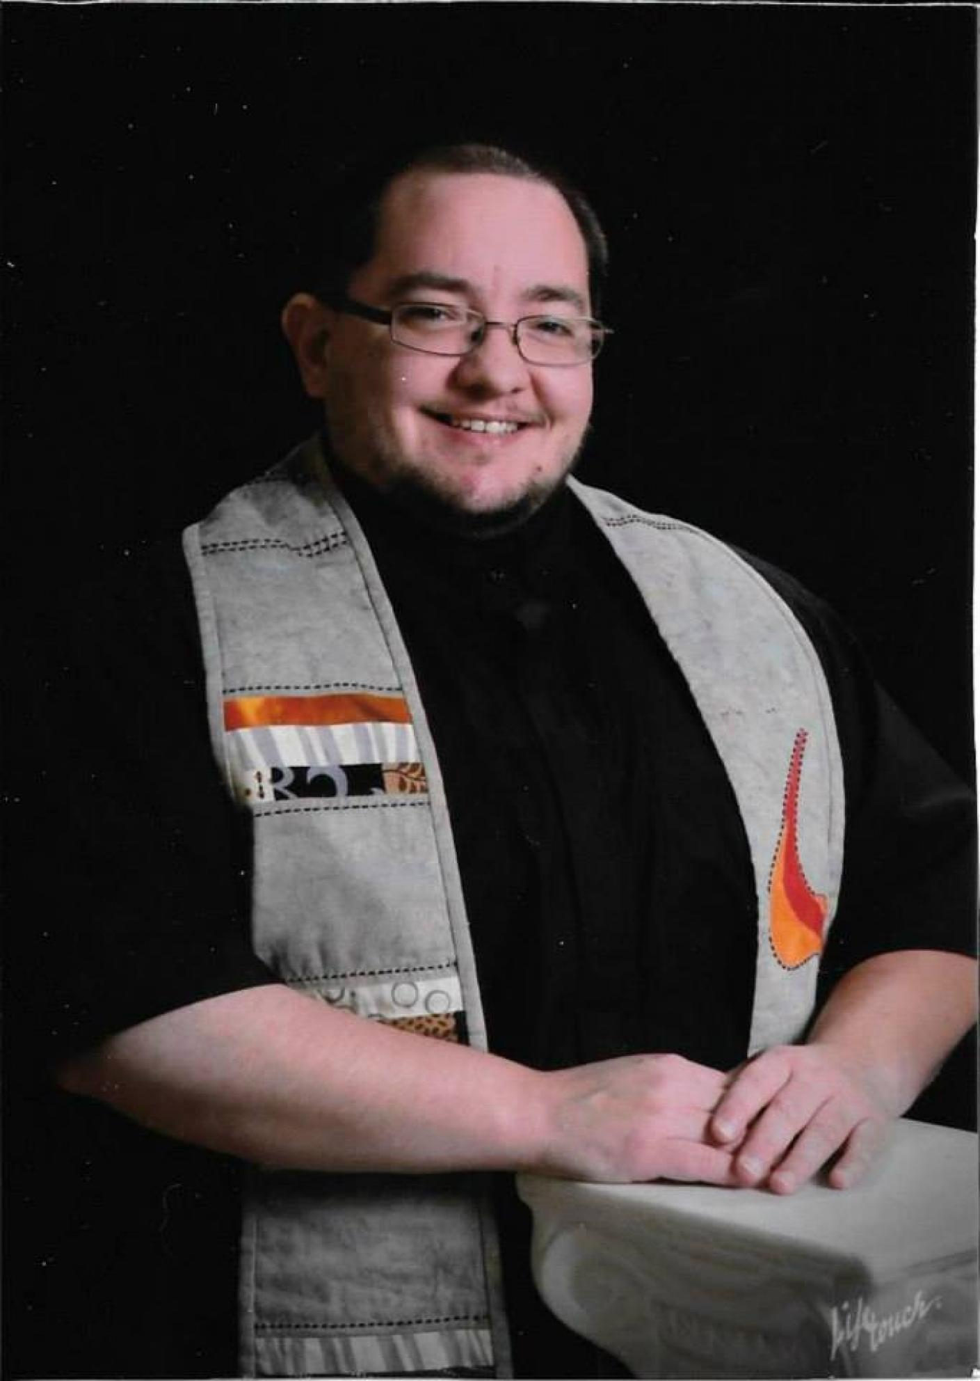
"In Faith" by Rev. Sunshine Jeremiah Wolfe
" This is a congregation that gathers in faith. Not faith in one religion or one god or any one way. We gather in faith of the power of diversity, the power of love, and the hope of a world transformed by our care. We gather in faith in ourselves and those around us. Not a faith that requires perfection or rightness in one another. Rather, a faith that in our shared imperfection we may learn to stumble and fall together. Faith that we will help one another to rise and to try again and again. We are Unitarian Universalists."

Slide 14
Chalice Lighting on Inherent Worth and Dignity
By Steve Stock
We light this chalice to celebrate the inherent worth and dignity of every person; To reaffirm the historic pledge of liberal religion to seek that justice which transcends mere legality and moves toward the resolution of true equality; And to share that love which is ultimately beyond even our cherished reason, that love which unites us.

Slide 15
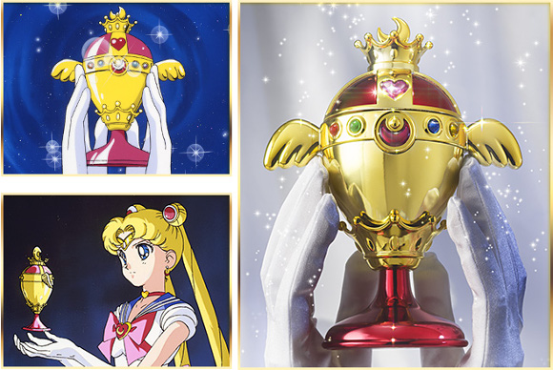
The Chalice
In the center of the picture is a flaming chalice, which represents the Unitarian Universalist Association (UUA) and is a known symbol for their faith. At the opening of a Unitarian Universalist worship service, many light a flame inside a chalice which unites members in worship as being a visual, concrete manifestation of their joined spirits.

Slide 16
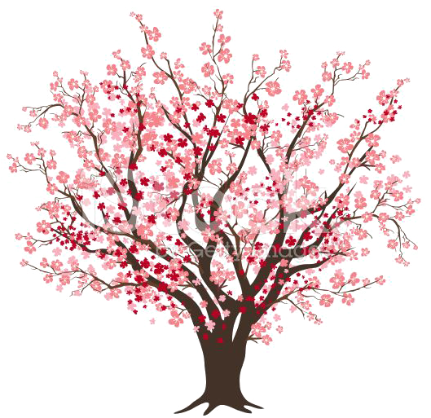
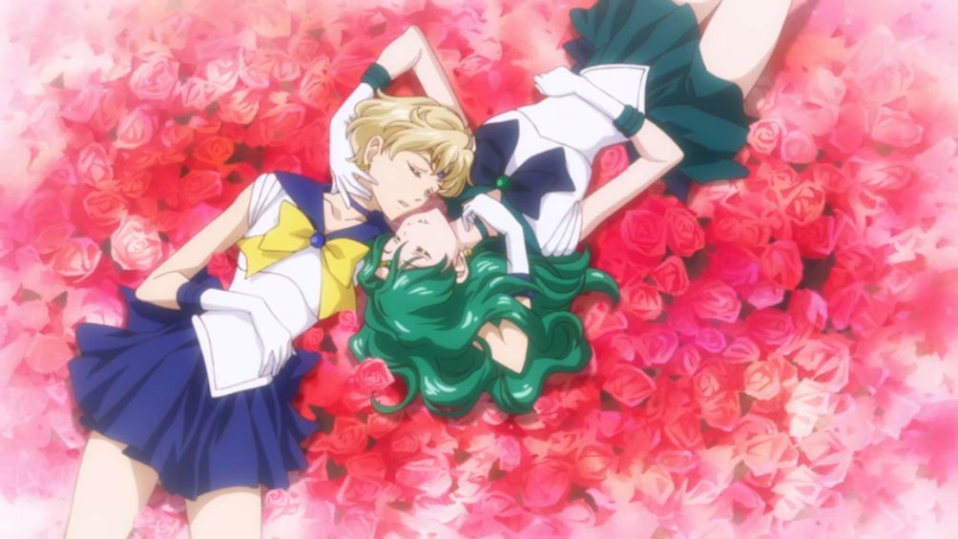
Quotes on "Dignity"
“Democracy is not just the right to vote, it is the right to live in dignity.” ― Naomi Klein
“The call to the creative life is a call to dignity, to a life of vulnerability and adventure and the call to a life that exquisite excitement and indeed ecstasy will often visit.” ― John O'Donohue
Every life deserves a certain amount of dignity, no matter how poor or damaged the shell that carries it. ― Rick Bragg

Slide 17
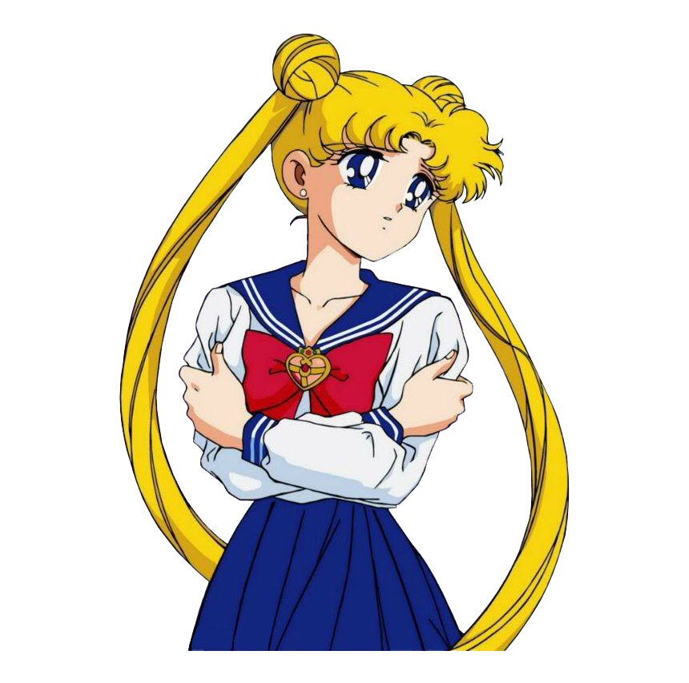
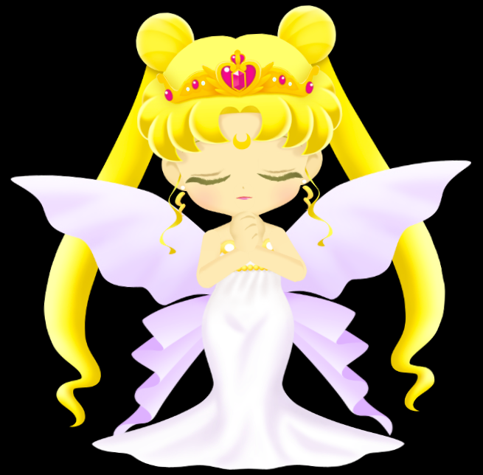
The Congregation Pauses for a Moment to Share "Joys and Concerns"
One member wishes another Happy Birthday
One talks about the devastation of Lake Charles by Hurricane Laura
One has a friend that she is worried about being a home health nurse during COVID
Another talks about how a neighbor passed away recently
I raise my hand and speak about feeling welcome and how surprised I am about how much I was enjoying myself during the meeting
My concern was about how hard of a time I've been having adjusting to what I dub as "civilian life" after having left my job unexpectedly on the last day of July.

Slide 18
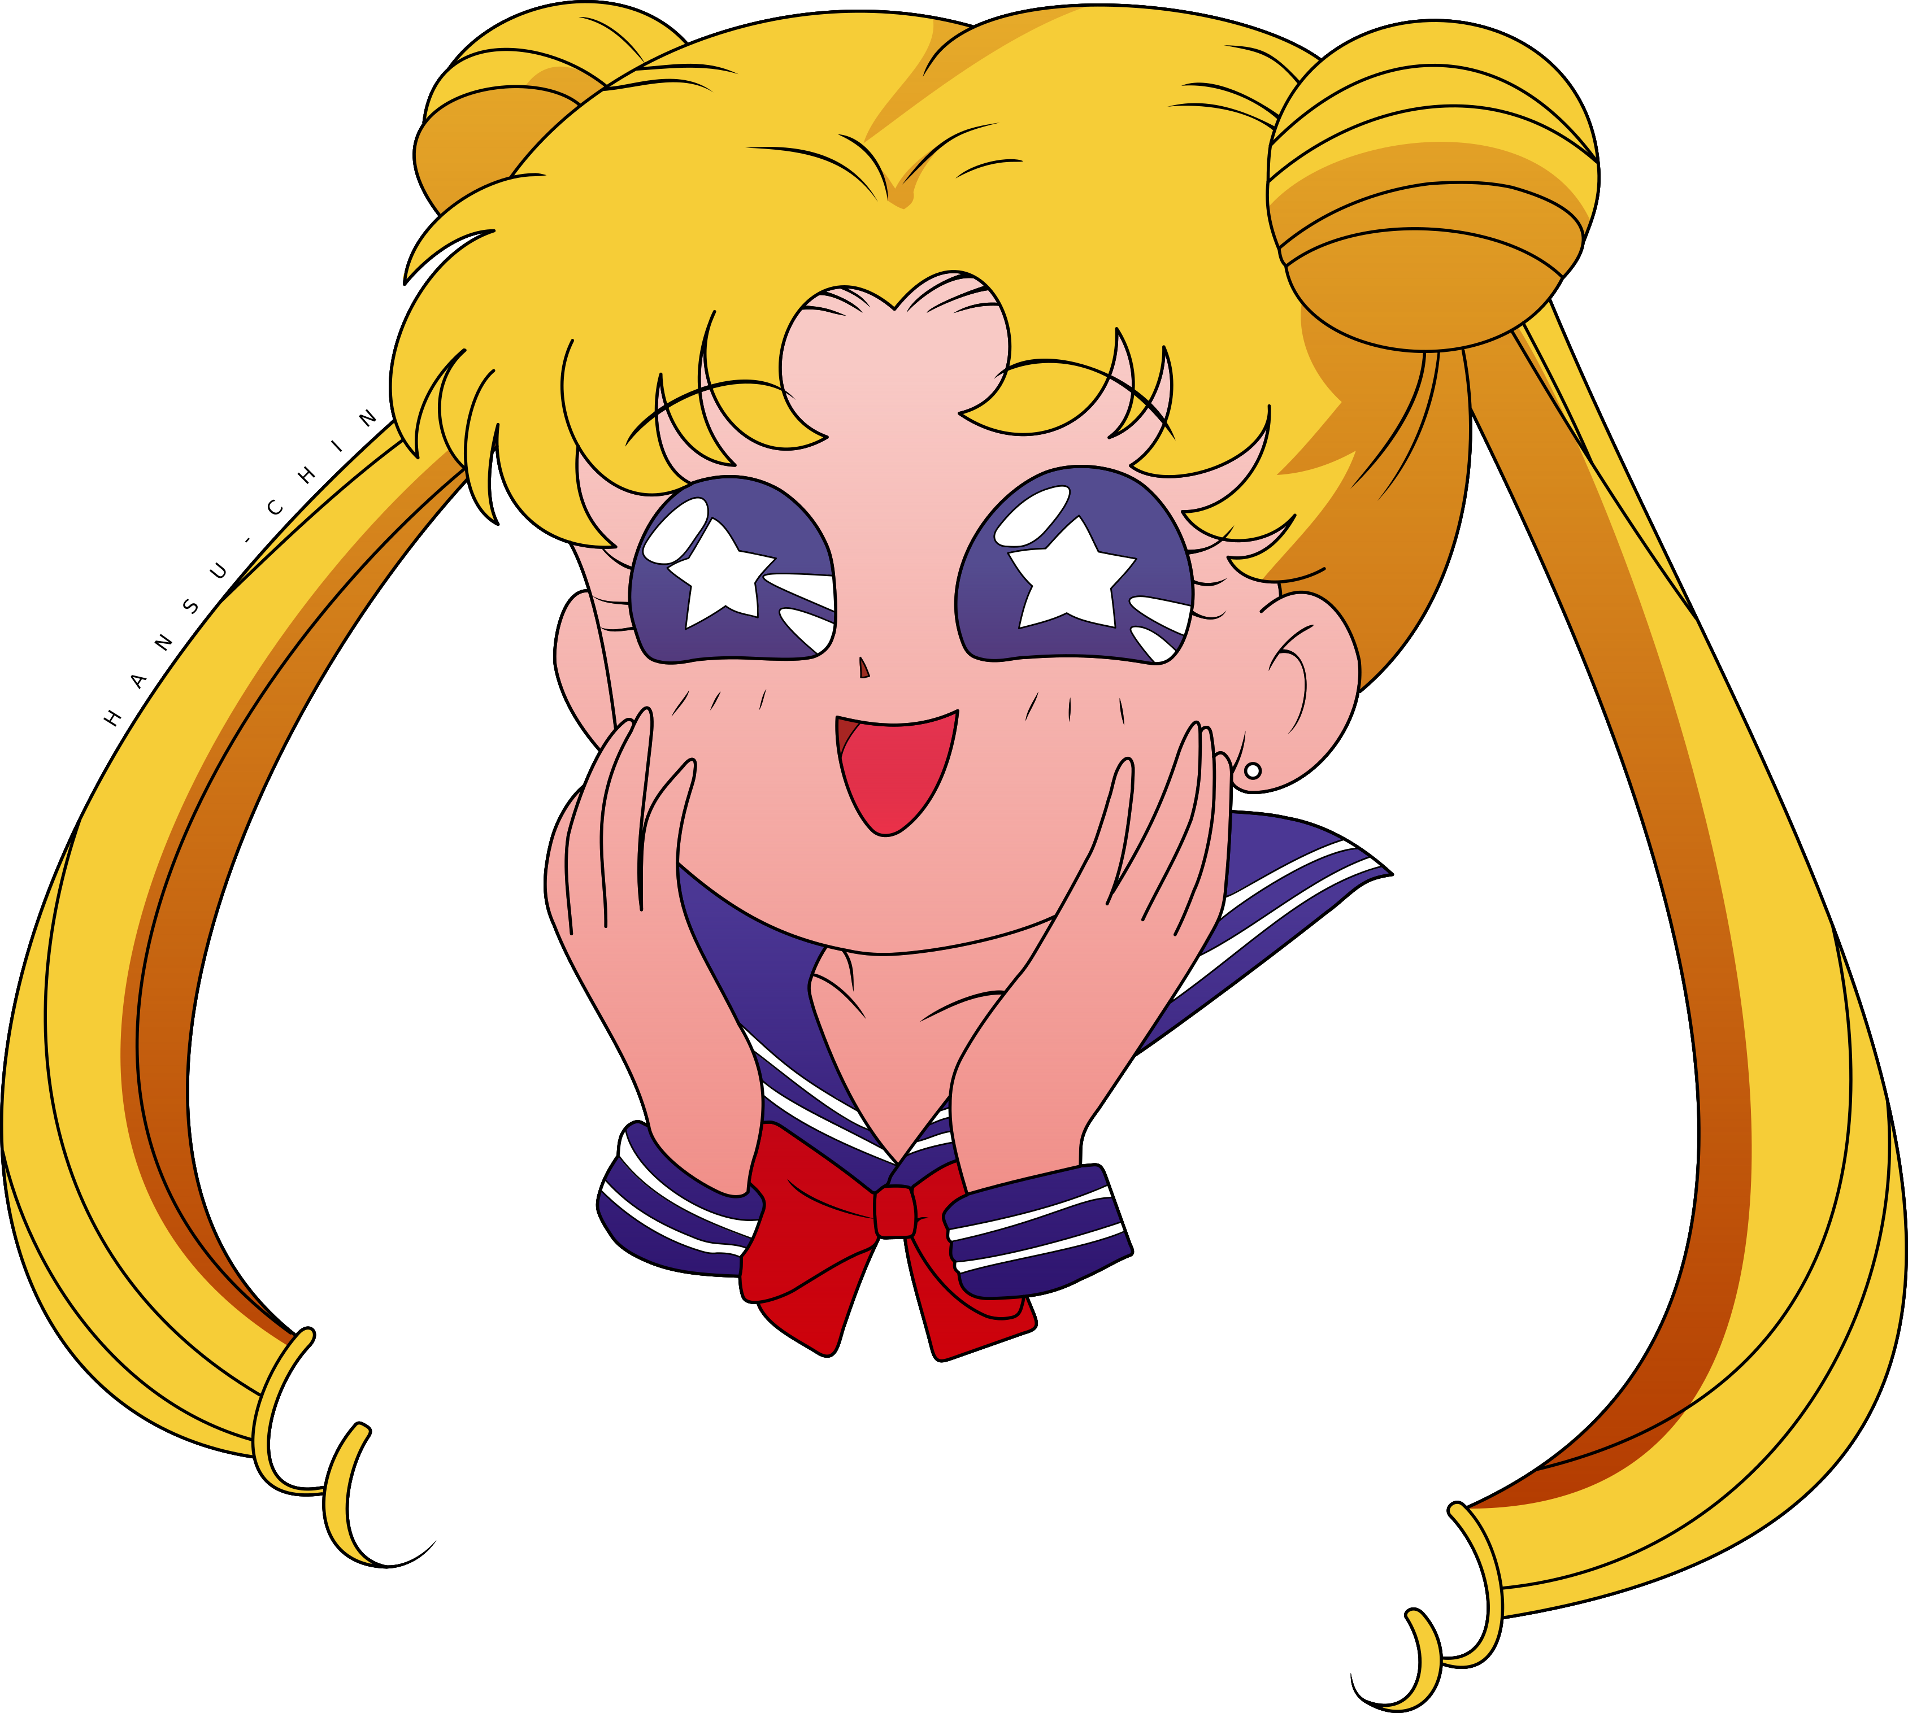
HYMN #1053 How Could Anyone
How could anyone ever tell you you were anything less than beautiful? How could anyone ever tell you you were less than whole? How could anyone fail to notice that your loving is a miracle? How deeply you’re connected to my soul.

Slide 19
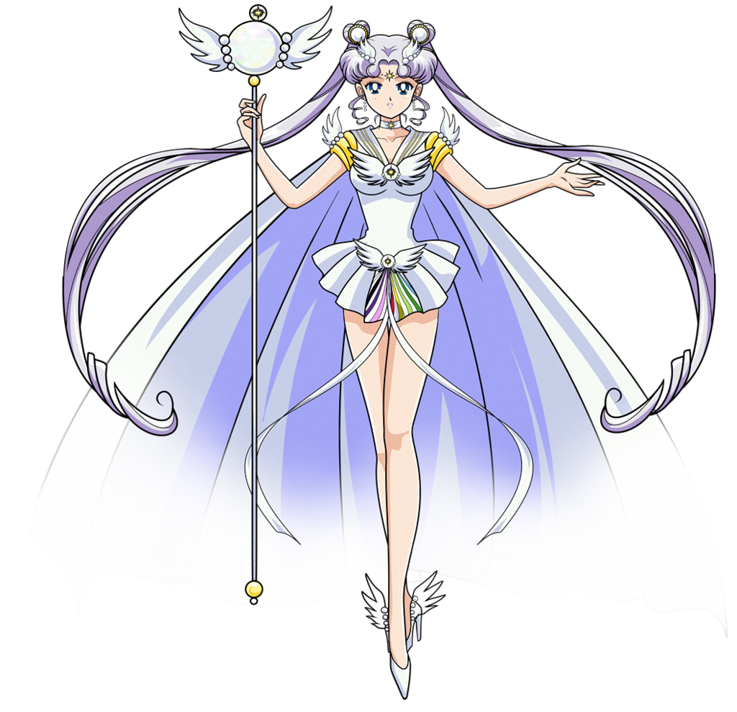
Somewhere around this point of the mass, I realized something big...
I was witnessing for what felt like the very first time in my life religion being practiced in its purest form...
Not to condem nor judge but to spread Love and Support.
These people were using their faith to help each other heal.
To even pass those healing powers on to use on an outsider like me...
I felt very moved suddenly and that left me feeling both confused yet grateful to have been able to be a partcipant in this human moment.

Slide 20
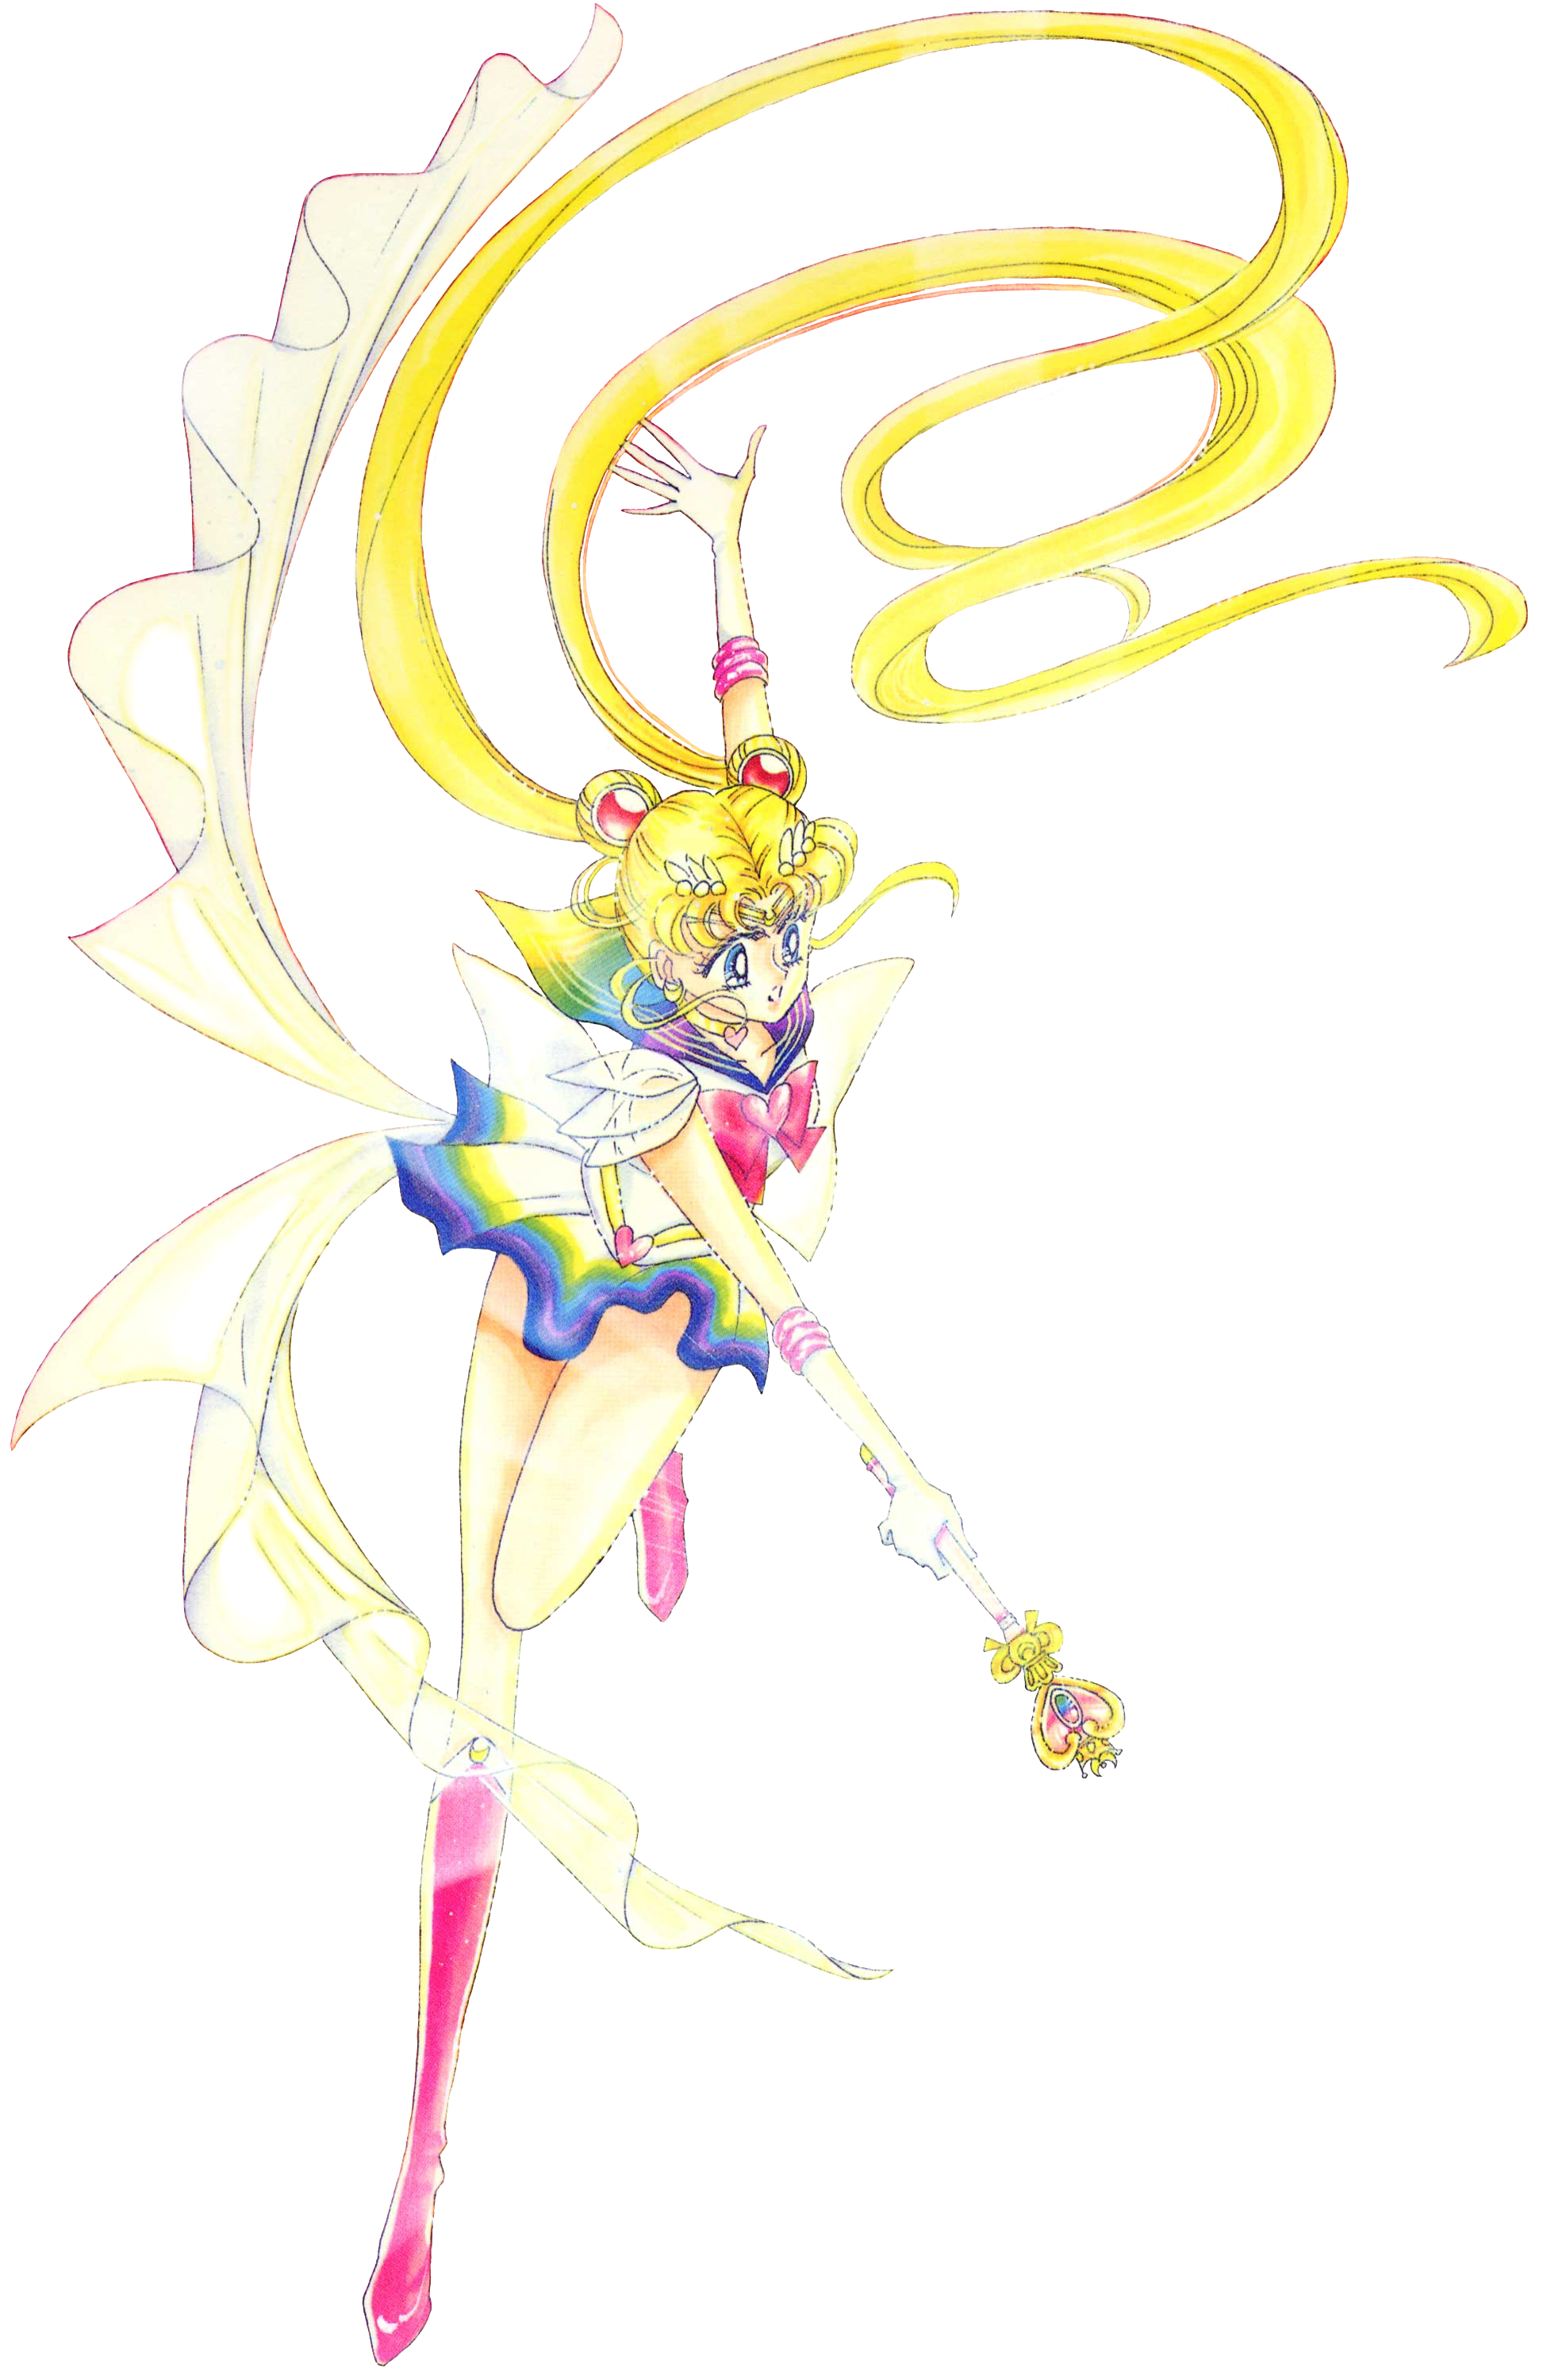
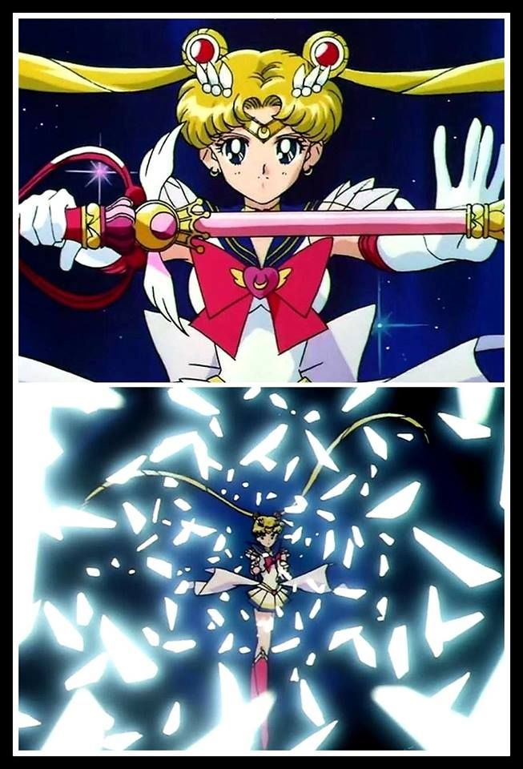
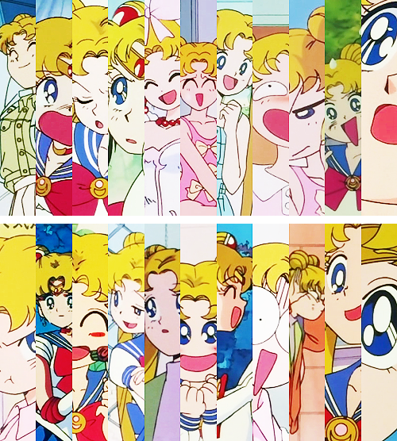
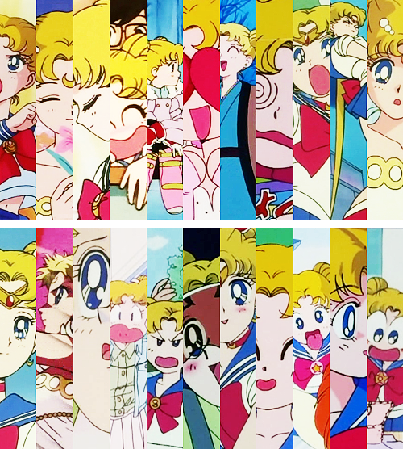
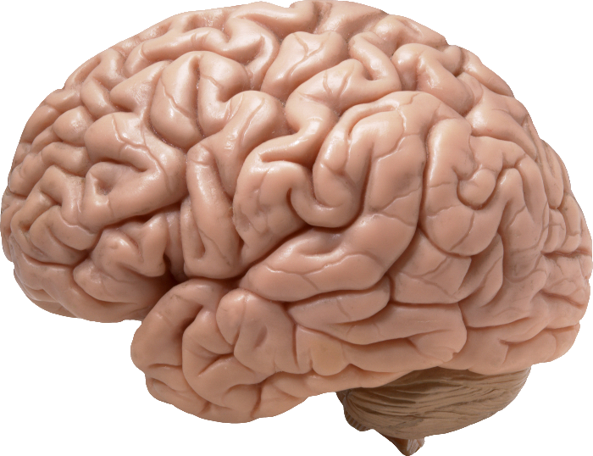

Slide 21
Attending my second meeting, mass and follow-up discussion with the Unitarian Universalist Fellowship of Lafayette, LA (9/13/2020)-10:30AM
I was excited to meet with the UU again and honestly wish I didn't have to take notes this time around so I could fully enjoy the experience.
I purposely dressed more outwardly femmine by wearing floral hair barrettes to test how "accepting of diversity" they so say claimed to be on their website.

Slide 22
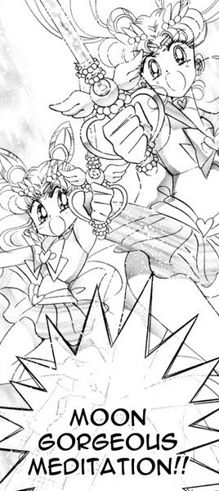
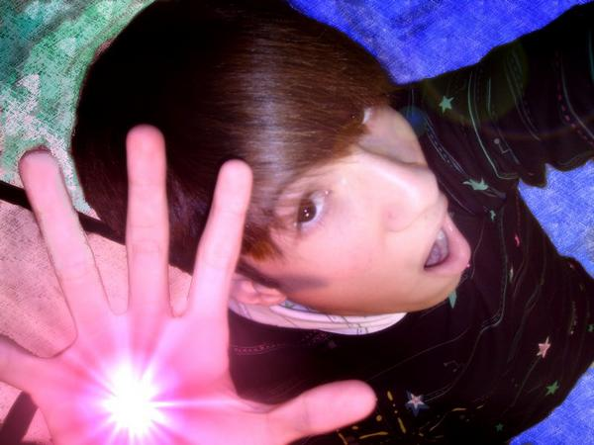

Slide 23
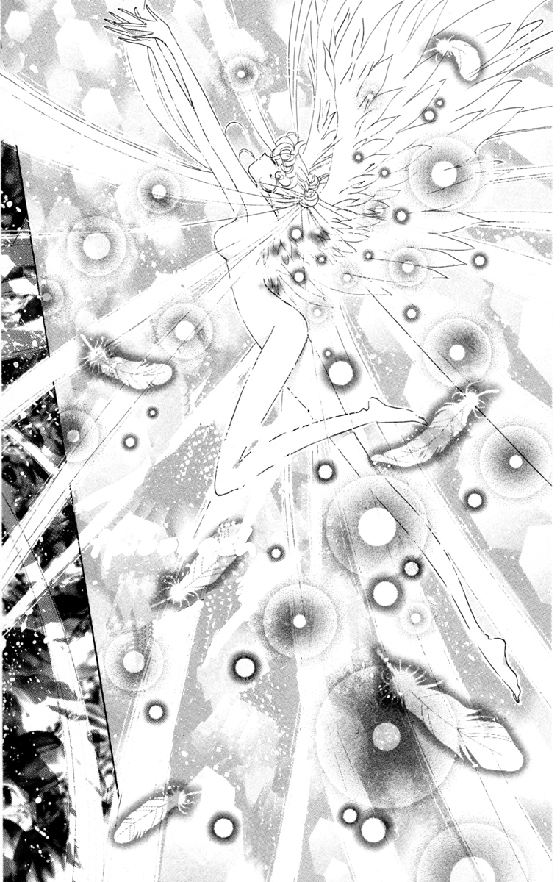
The Lasting Impression of this Project In Regards to My Future Career as a Counselor...
I finally found a diverse and accepting community that resonates with my own ecletic sense of practicing spirituality
Through time, and the continued collection of meaningful experiences with my time spent with the UU, I can begin to familarize myself to belief systems and spiritual teachings from around the world instead of just the few western ones that have largely shaped my past, negative thoughts towards religion.
I will become more accustomed to the idea of religion being a subject that can be enjoyable to talk about over one that arouses resenment like in my past.

Slide 24
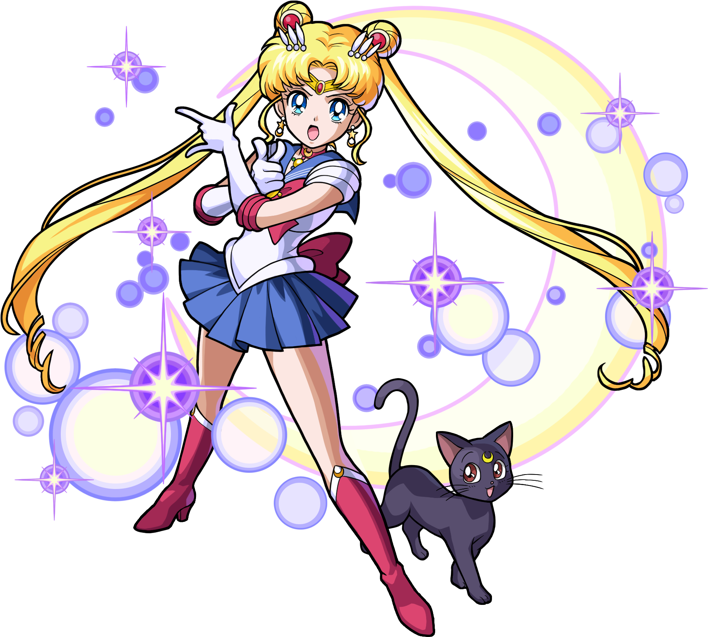
My Current Spiritual Agenda Since This Project!?
Keep meeting with the lovely members of the UU Lafayette chapter every sunday on Zoom
Eventually meet up at their church in person after 2020/ the pandemic calms the *(#@^&)* down!!!

Slide 25
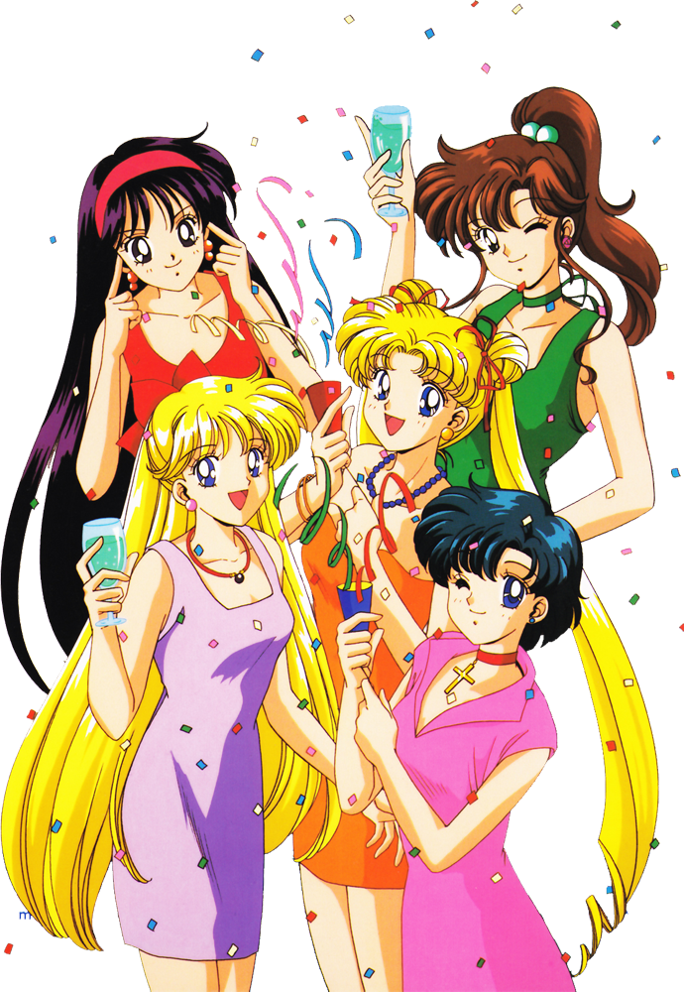
Remember to make time to Celebrate LOVE and LIFE!!!
And to PARTY when reconnecting with friends and loved ones after this pandemic mess is all said and done with!

Slide 26
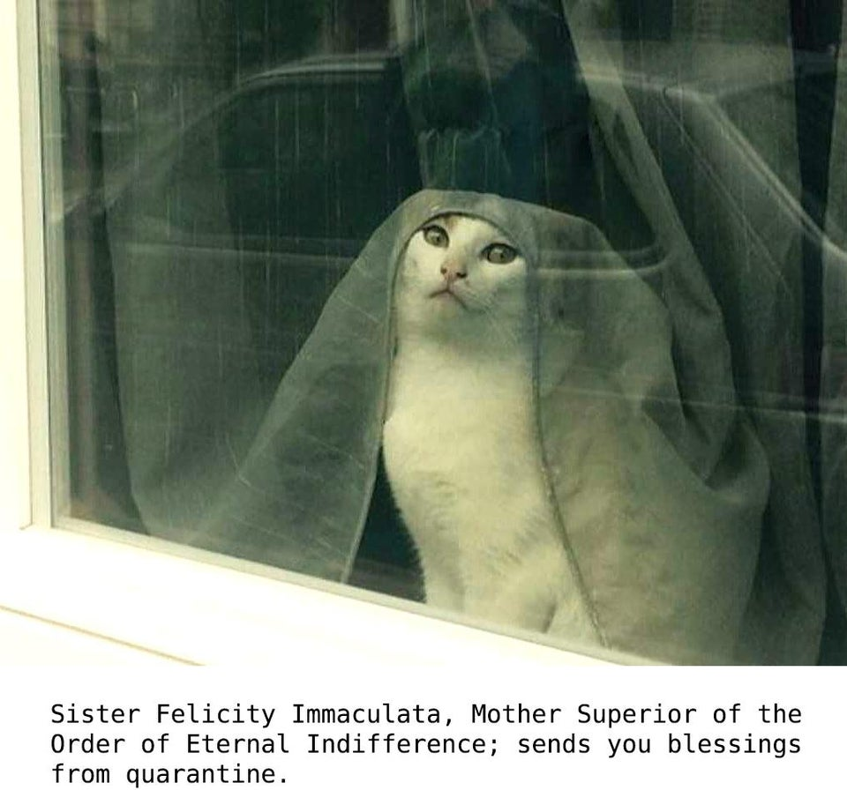
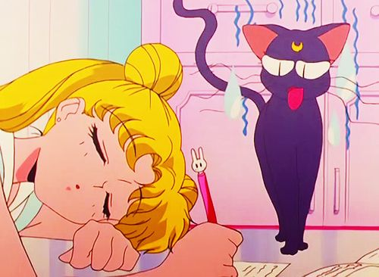
FIN

Slide 27
Work Cited
Lee, W Richard. 1996. “Strained Bedfellows: Pagans, New Agers, and "Starchy Humanists" in Unitarian Universalism”. Religion Compass 7, no. 1: 15–24.
McKanan, Daniel. 2013. “Unitarianism, Universalism, and Unitarian Universalism”. Religious Humanism,vol. 30, nos. 1 & 2, winter/spring 1996, p. 7-29

